Slide 1

Software system for Store chain
Inception – Team 2
VineSoft Ltd.
Gunesh Shefkedov
Radostin Ivanov
Ilia Mutafov
Stefan Nedelchev
Tonka Tencheva

Slide 2
Software system for Store chain
Software development plan
Document purpose;
Scope;
Project:
Purpose;
Constraints;
VineSoft Ltd.
Gunesh Shefkedov
Radostin Ivanov
Ilia Mutafov
Stefan Nedelchev
Tonka Tencheva

Slide 3
Software system for Store chain
Software MODULES
System;
Warehouse;
Deliveries;
Human Resources;
Marketing;
VineSoft Ltd.
Gunesh Shefkedov
Radostin Ivanov
Ilia Mutafov
Stefan Nedelchev
Tonka Tencheva

Slide 4
Software system for Store chain
Software MODULES
Client;
Finances;
Contracts;
Material Resources;
Parking;
VineSoft Ltd.
Gunesh Shefkedov
Radostin Ivanov
Ilia Mutafov
Stefan Nedelchev
Tonka Tencheva

Slide 5
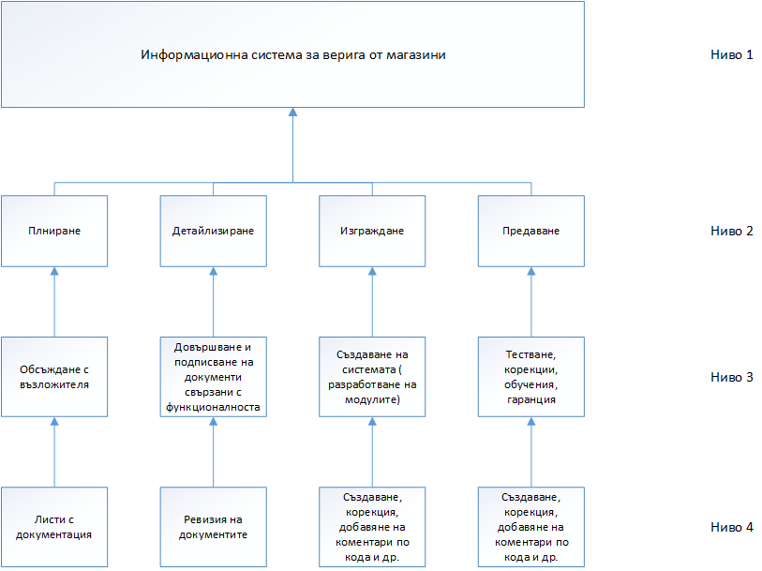
Software system for Store chain
Project Plan
Work breakdown structure
VineSoft Ltd.
Gunesh Shefkedov
Radostin Ivanov
Ilia Mutafov
Stefan Nedelchev
Tonka Tencheva

Slide 6
Software system for Store chain
Software development plan
Schedule;
Budged;
VineSoft Ltd.
Gunesh Shefkedov
Radostin Ivanov
Ilia Mutafov
Stefan Nedelchev
Tonka Tencheva

Slide 7
Software system for Store chain
Quality assurance plan
Introduction;
Quality Objectives – ref.;
Management;
Documentation;
Standarts and Guidelines;
Metrics;
VineSoft Ltd.
Gunesh Shefkedov
Radostin Ivanov
Ilia Mutafov
Stefan Nedelchev
Tonka Tencheva

Slide 8
Software system for Store chain
Quality assurance plan
Review and Audit Plan;
Evaluation and Test – ref.;
Problem Resolution and Corrective Action – ref.;
Tools, Techniques and Methodologies;
VineSoft Ltd.
Gunesh Shefkedov
Radostin Ivanov
Ilia Mutafov
Stefan Nedelchev
Tonka Tencheva

Slide 9
Software system for Store chain
Quality assurance plan
Configuration Management - ref;
Quality Records;
Risk Management;
VineSoft Ltd.
Gunesh Shefkedov
Radostin Ivanov
Ilia Mutafov
Stefan Nedelchev
Tonka Tencheva

Slide 10
Software system for Store chain
Vision
VineSoft Ltd.
Gunesh Shefkedov
Radostin Ivanov
Ilia Mutafov
Stefan Nedelchev
Tonka Tencheva

Slide 11
Software system for Store chain
Glossary
Introduction;
Purpose;
Range;
VineSoft Ltd.
Gunesh Shefkedov
Radostin Ivanov
Ilia Mutafov
Stefan Nedelchev
Tonka Tencheva

